Slide 1


Robson Tadeu da Cruz Santos
2022-11-30

Slide 2

Outline
Executive Summary
Introduction
Methodology
Results
Conclusion
Appendix

Slide 3
Executive Summary
Summary of methodologies
Data Collection using API e Web Scraping
Data Wrangling
EDA with SQL
EDA with data visualization
Prediction using Machine Learning
Summary of all results
EDA results
Predictiove results

Slide 4
Introduction
Project background and context
Optimize Space X Falcon 9 cost launches using machine learning;
Problems you want to find answers
How to ensure a success program;

Slide 5

Section 1

Slide 6
Methodology
Executive Summary
Data collection methodology:
Collected using SpaceX API and Web scraping
Perform data wrangling
Applied transformations to features
Perform exploratory data analysis (EDA) using visualization and SQL
Perform interactive visual analytics using Folium and Plotly Dash
Perform predictive analysis using classification models

Slide 7
Data Collection
Done using requests to the SpaceX API;
Transform response to json then to a pandas DataFrame;
Clean data;
Done web scraping from wikipedia;

Slide 8
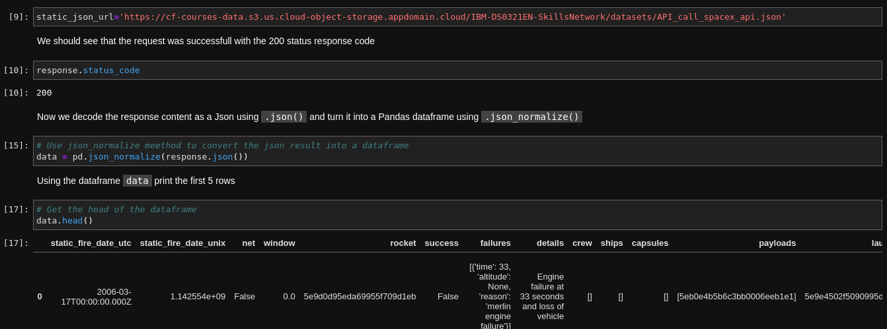
Data Collection – SpaceX API
Response converted to a pandas DataFrame
Link notebook: https://github.com/robsonsan/IBM_Coursera_Final_Assignment/blob/main/01.data-collection-api.ipynb

Slide 9
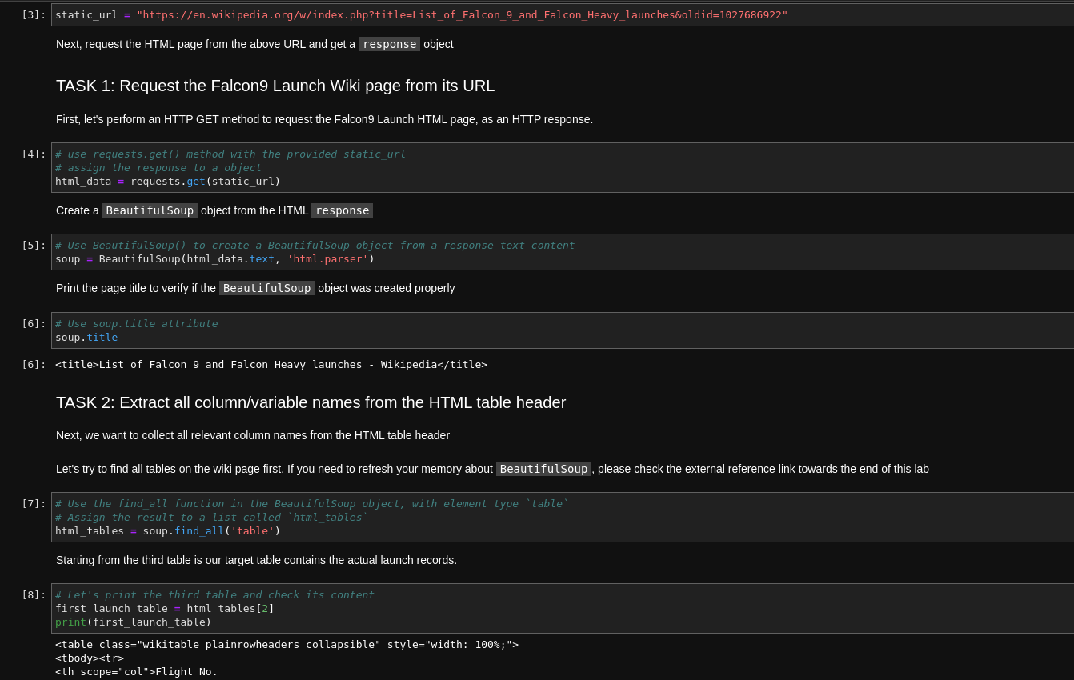
Data Collection - Scraping
Applied web scraping to Falcon 9 records
Link notebook: https://github.com/robsonsan/IBM_Coursera_Final_Assignment/blob/main/02.webscraping.ipynb

Slide 10
Data Wrangling
EDA to identity main features
Exporting results to csv
Link notebook: https://github.com/robsonsan/IBM_Coursera_Final_Assignment/blob/main/03.Data%20wrangling.ipynb

Slide 11
EDA with Data Visualization
Exploring the relationship between features
Link notebook: https://github.com/robsonsan/IBM_Coursera_Final_Assignment/blob/main/05.Dataviz.ipynb

Slide 12
EDA with SQL
Saving data in a Sqlite database
Link notebook: https://github.com/robsonsan/IBM_Coursera_Final_Assignment/blob/main/04.%20sqllite.ipynb

Slide 13
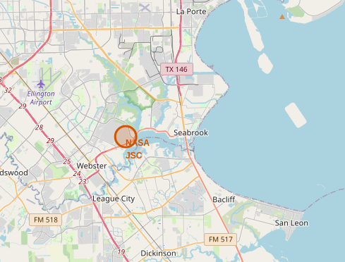
Build an Interactive Map with Folium
Marked launch sites
Added lines to mark success or failure;
Calculated the distances between a launch site to its proximities;
Link notebook: https://github.com/robsonsan/IBM_Coursera_Final_Assignment/blob/main/06.site_location.ipynb

Slide 14
Predictive Analysis (Classification)
Loaded data using numpy and pandas;
Data was transformed and splitted into train and testing;
Metric: Accuracy
Link notebook: https://github.com/robsonsan/IBM_Coursera_Final_Assignment/blob/main/07.machine_learning.ipynb

Slide 15
Results
Exploratory data analysis results
Interactive analytics demo in screenshots
Predictive analysis results

Slide 16

Section 2

Slide 17
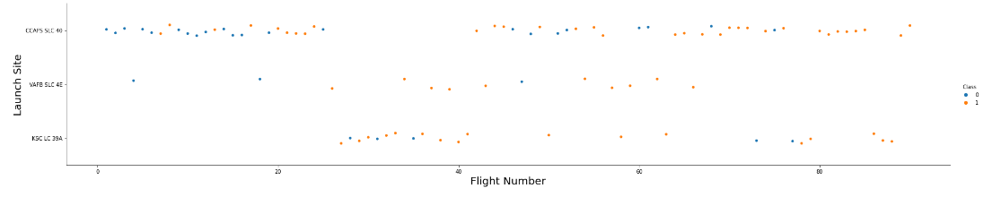
Flight Number vs. Launch Site
Flight number vs Launch site

Slide 18
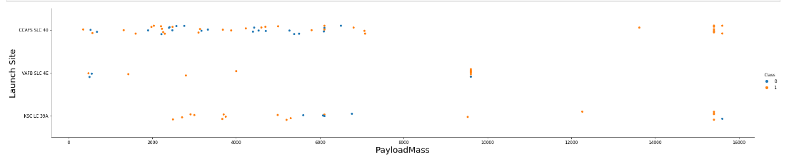
Payload vs. Launch Site
Payload vs Launch site

Slide 19
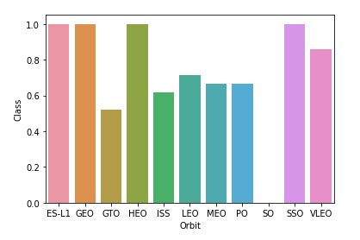
Success Rate vs. Orbit Type
Success Rate vs Orbit Type

Slide 20
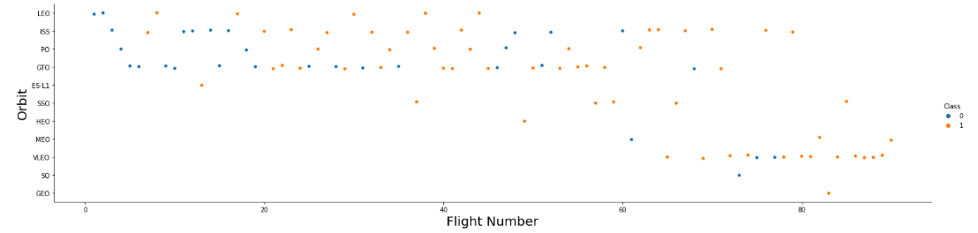
Flight Number vs. Orbit Type
Flight Number vs Orbit Type

Slide 21
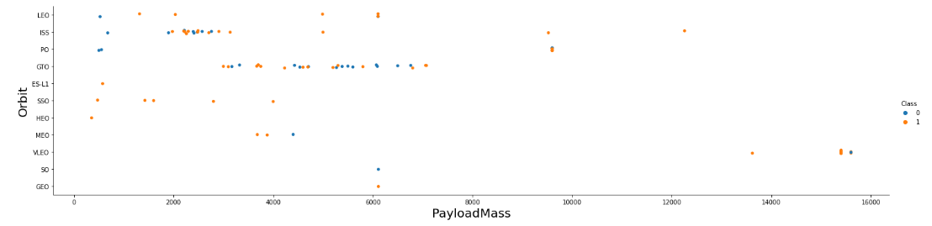
Payload vs. Orbit Type
Payload vs Orbit Type

Slide 22
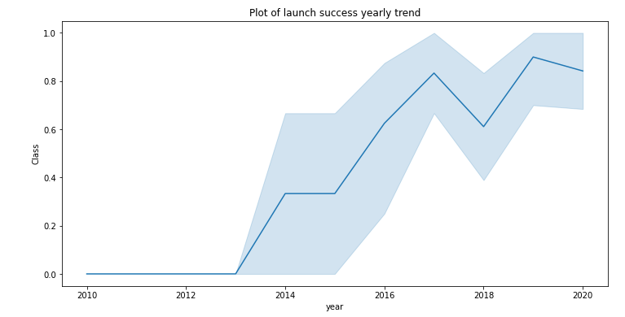
Launch Success Yearly Trend
Launch Success Yearly Trend

Slide 23
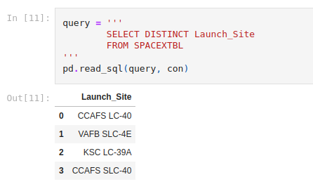
All Launch Site Names
All launch site names;

Slide 24
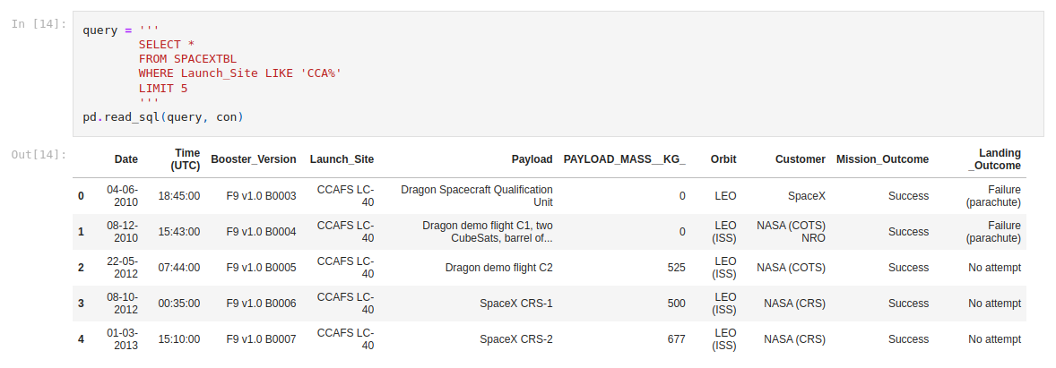
Launch Site Names Begin with 'CCA'
Launch site names begin with 'CCA'

Slide 25
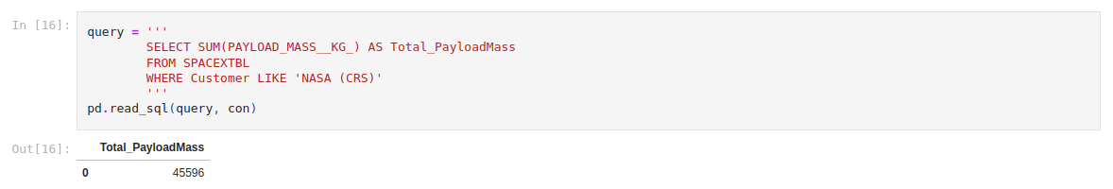
Total Payload Mass
Total Payload Mass

Slide 26
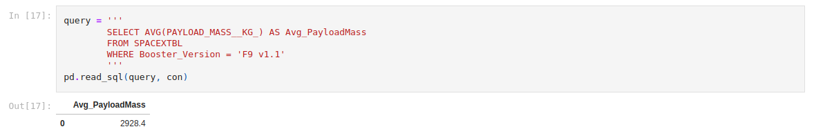
Average Payload Mass by F9 v1.1
Average Payload Mass;

Slide 27
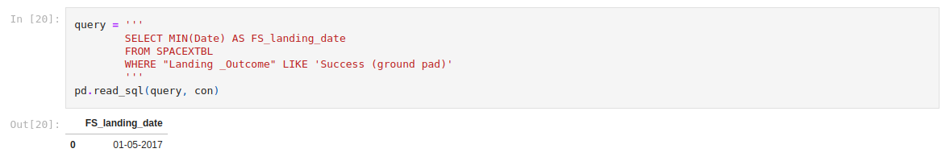
First Successful Ground Landing Date
Ground landing;

Slide 28
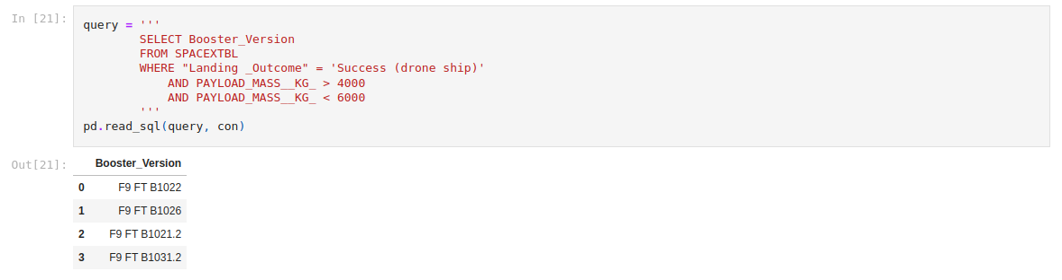
Successful Drone Ship Landing with Payload between 4000 and 6000
Successful drone ship

Slide 29
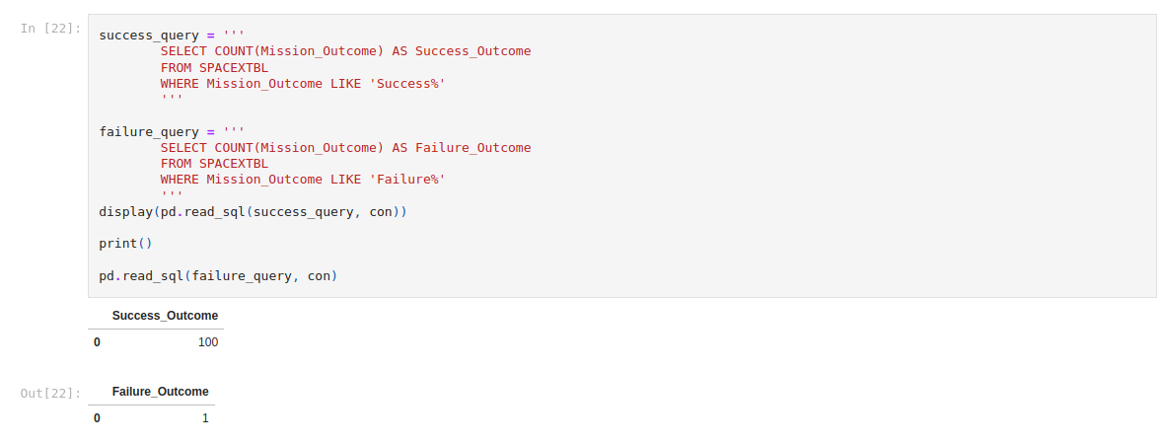
Total Number of Successful and Failure Mission Outcomes

Slide 30
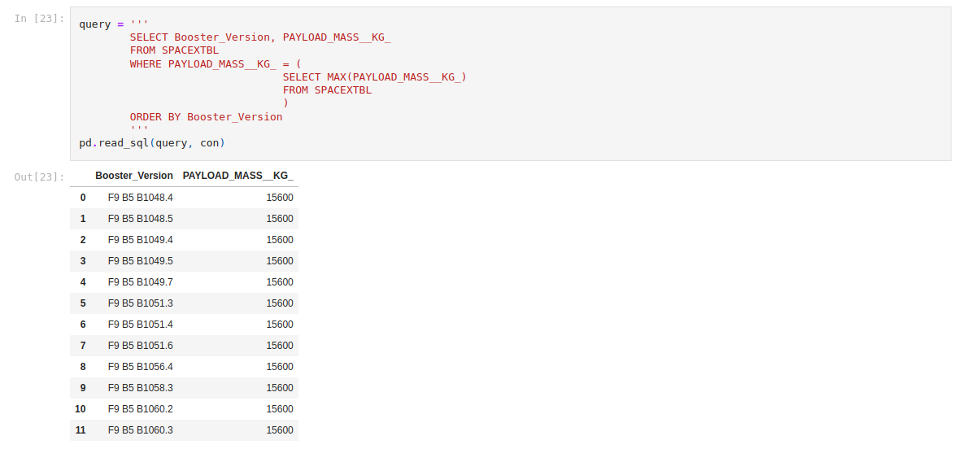
Boosters Carried Maximum Payload

Slide 31

Section 3

Slide 32

<Folium Map Screenshot 1>

Slide 33
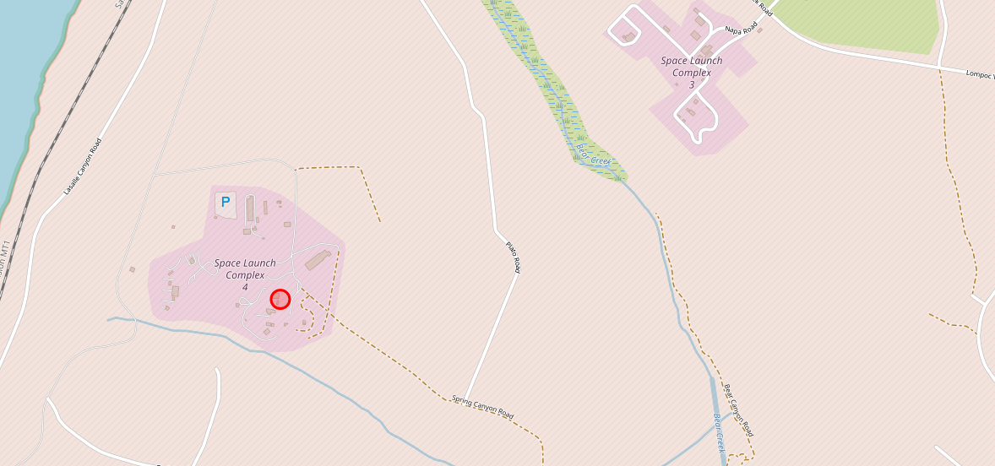
<Folium Map Screenshot 2>

Slide 34

Section 5

Slide 35
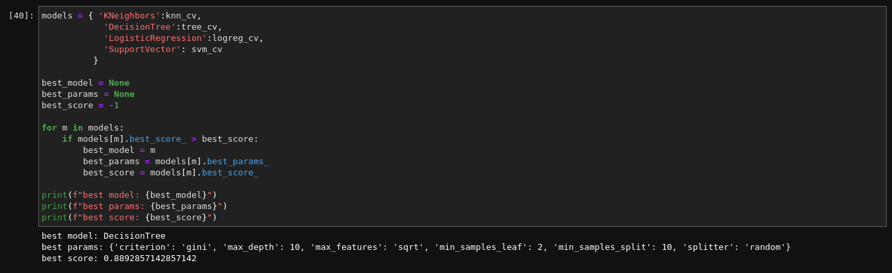
Classification Accuracy

Slide 36
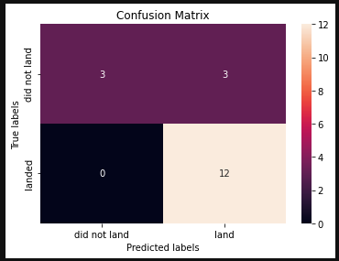
Confusion Matrix

Slide 37
Conclusions
Larger fight amount implies greater success rate
Decision tree classifier is the best ML algorithm

Slide 38


